Slide 1
uLANDS Analysis Update
Peter Boorman, Poshak Gandhi & the NuSTAR AGN Team
Obscured AGN Telecon • Oct 22nd 2019 • peter.boorman@asu.cas.cz

Slide 2
Outline
Brief recap of survey strategy
Current MCMC fitting
Nested sampling
Future plan

Slide 3
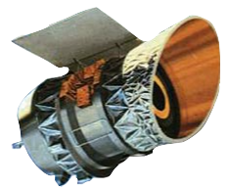
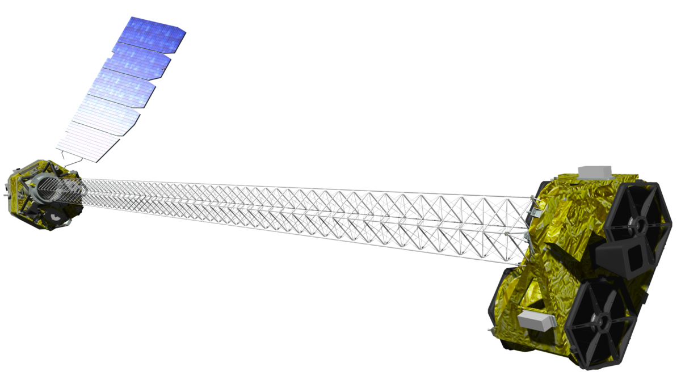
Our Survey Strategy
Isotropic infrared selection
Classification:
Infrared warm colours
Optical AGN lines
X-ray spectra
IRAS
NuSTAR
3

Slide 4
X-ray Classification – 1 Ms with NuSTAR
Boorman+,in prep.
uLANDS = NuSTAR LOCAL AGN N_{H} DISTRIBUTION SURVEY

Slide 5
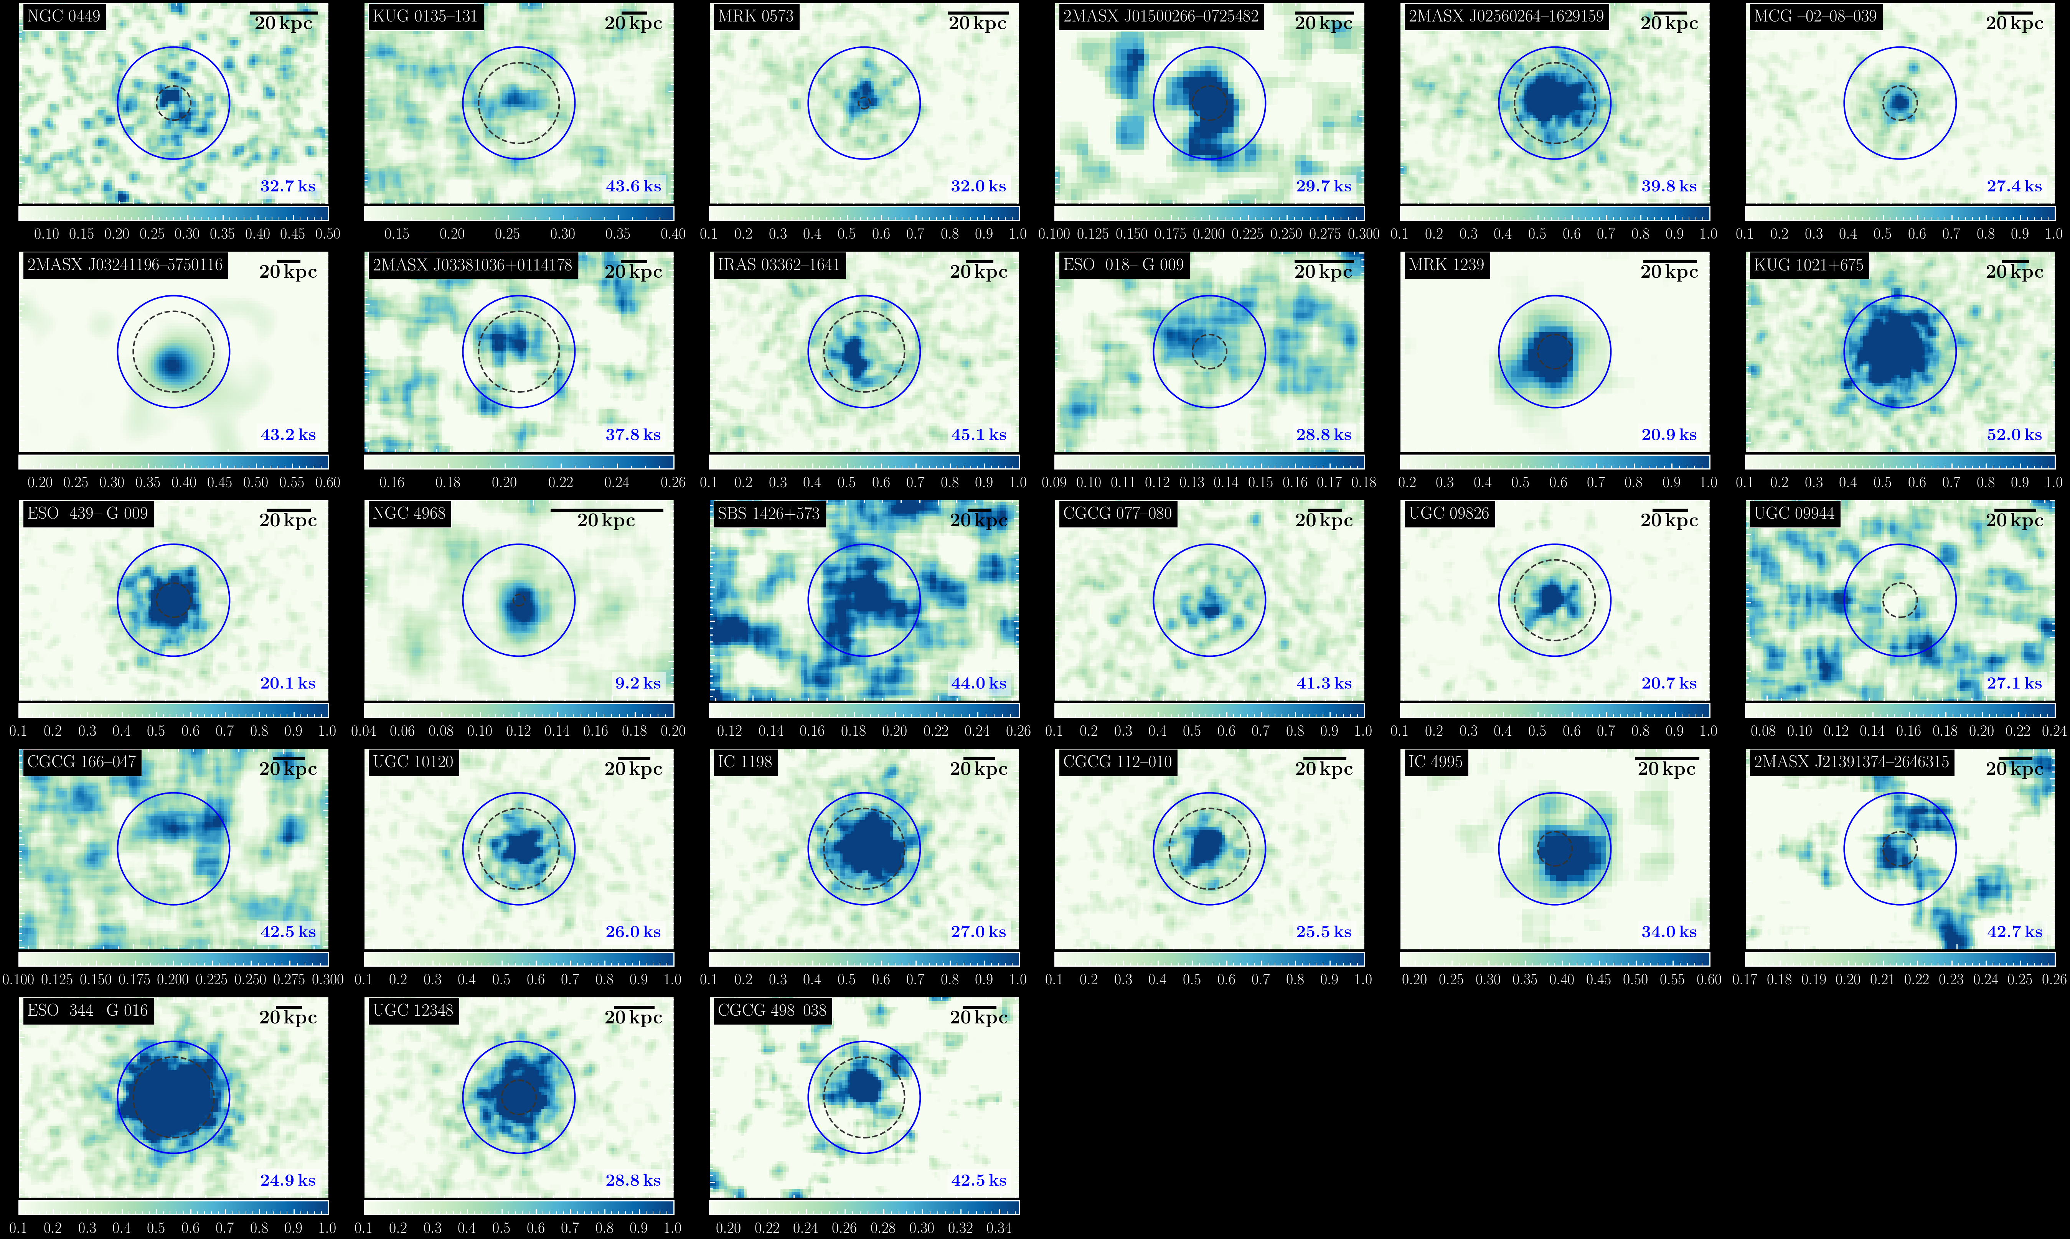
FPMA 8–24 keV
Dec.
Boorman+,in prep.
R. A.
5

Slide 6
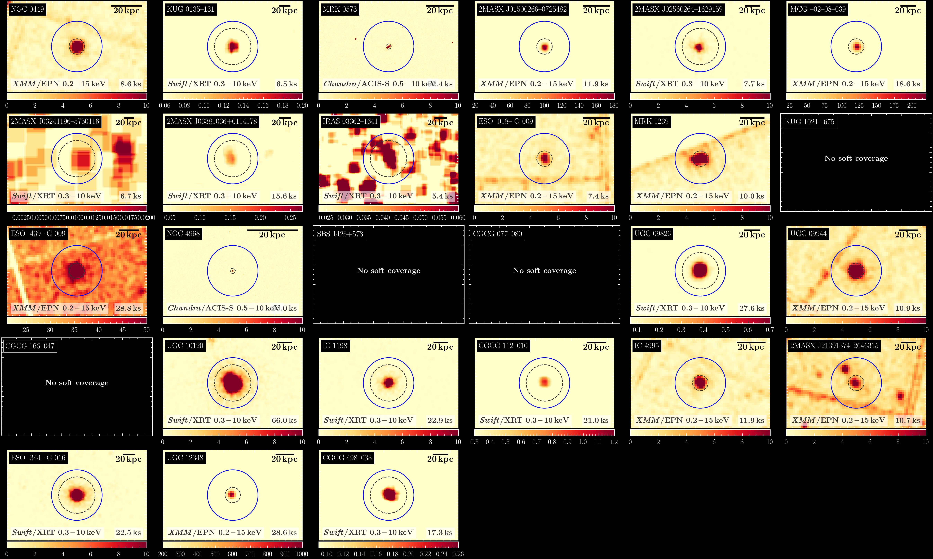
Soft coverage
Dec.
Boorman+,in prep.
R. A.
6

Slide 7
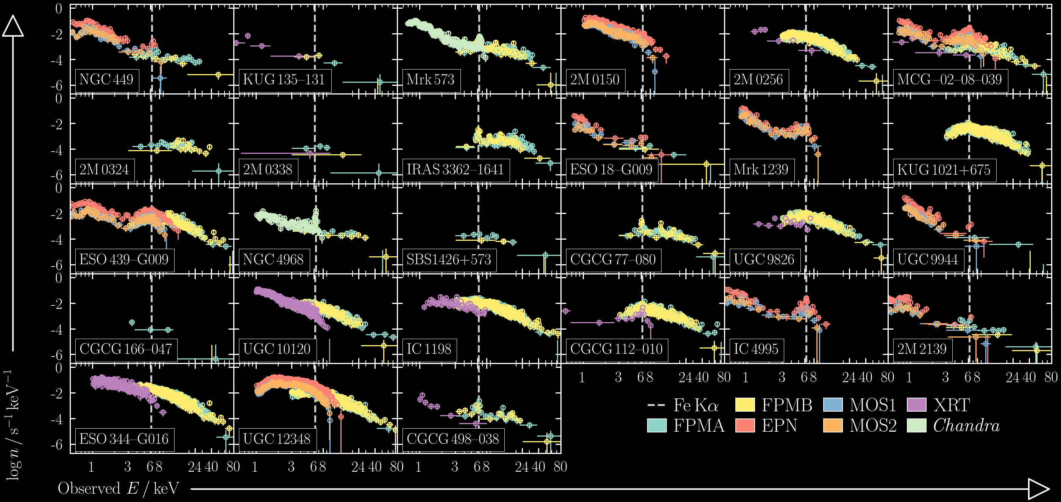
Observed X-ray spectra
Boorman+,in prep.
7
Notes:
27 shown here
Remaining in prep.

Slide 8
Outline
Brief recap of survey strategy
Current MCMC fitting
Nested sampling
Future plan
Notes:
What do other selection strategies tell us?

Slide 9
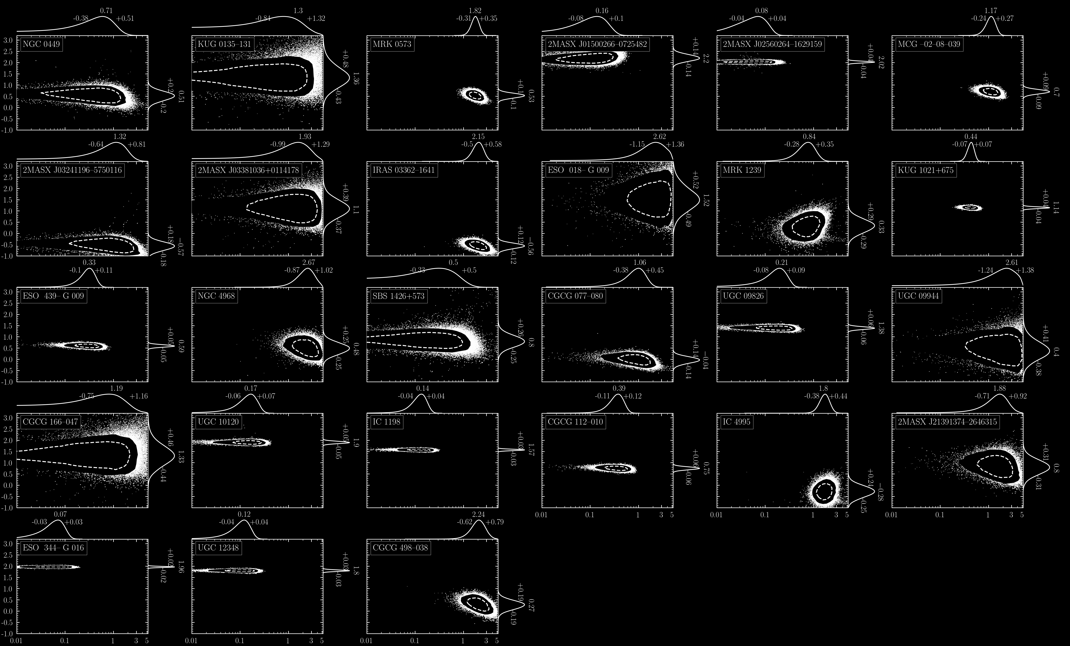
Boorman+,in prep.
zpowerlw + zgauss
𝛤 ₈₋₂₄
Observed properties
1σ
90%
EW_{Fe K⍺}/keV
9

Slide 10
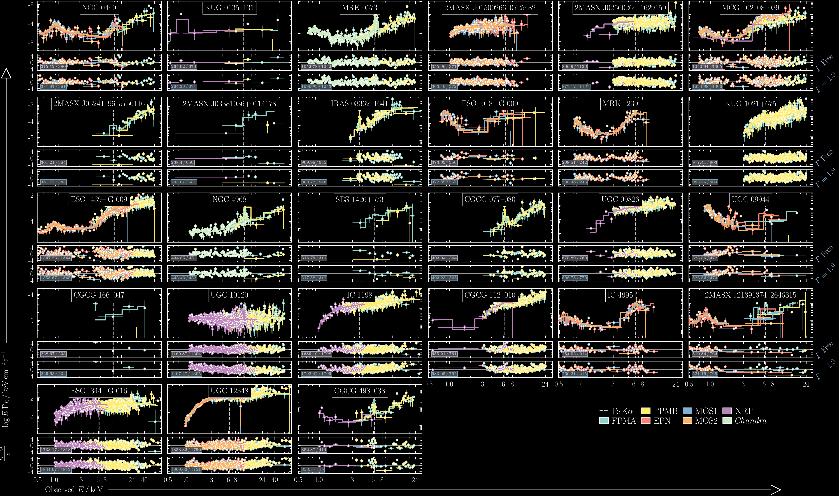
borus02 (N_{H} > 10²²) / pexmon (N_{H} < 10²²)
Boorman+,in prep.
Spectral fits
10

Slide 11
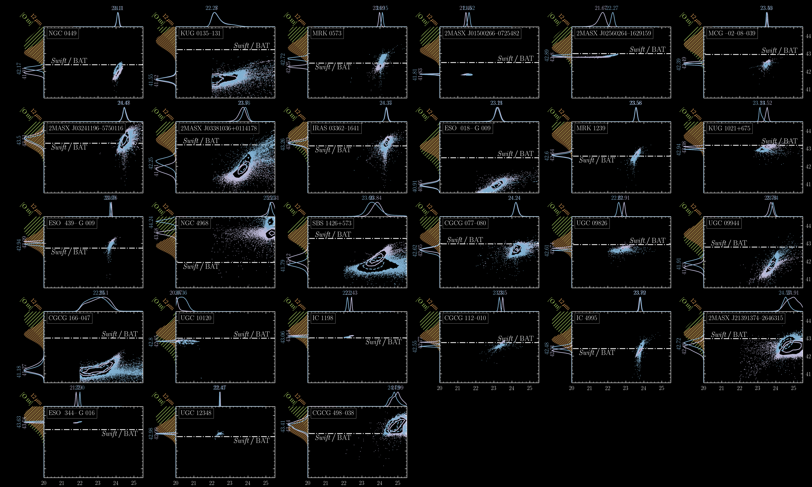
Boorman+,in prep.
borus or pexmon (log N_{H} > or < 22)
log L₂₋₁₀ / erg s⁻¹
Intrinsic properties
𝛤 free
𝛤 = 1.9
log N_{H} / cm⁻²
11

Slide 12
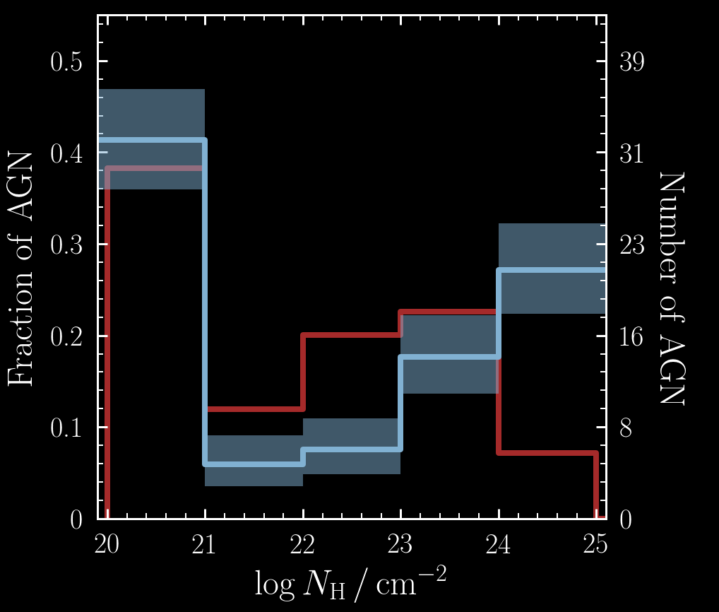
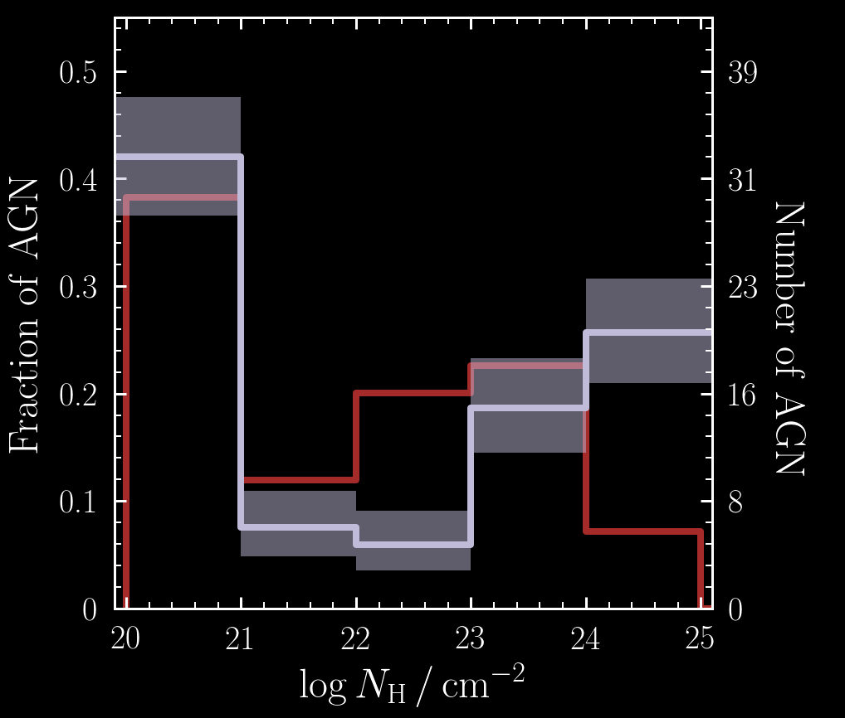
Directly Observed N_{H} Distribution (78/84)
NuLANDS 𝛤 free
NuLANDS 𝛤 =1.9
Swift/BAT (observed)
Boorman+,in prep.
Boorman+,in prep.

Slide 13
Compton-thick AGN with distance
Compton-thick fraction ~26-40%
Uniform with distance
Boorman+,in prep.
13

Slide 14
Outline
Brief recap of survey strategy
Current MCMC fitting
Nested sampling
Future plan

Slide 15


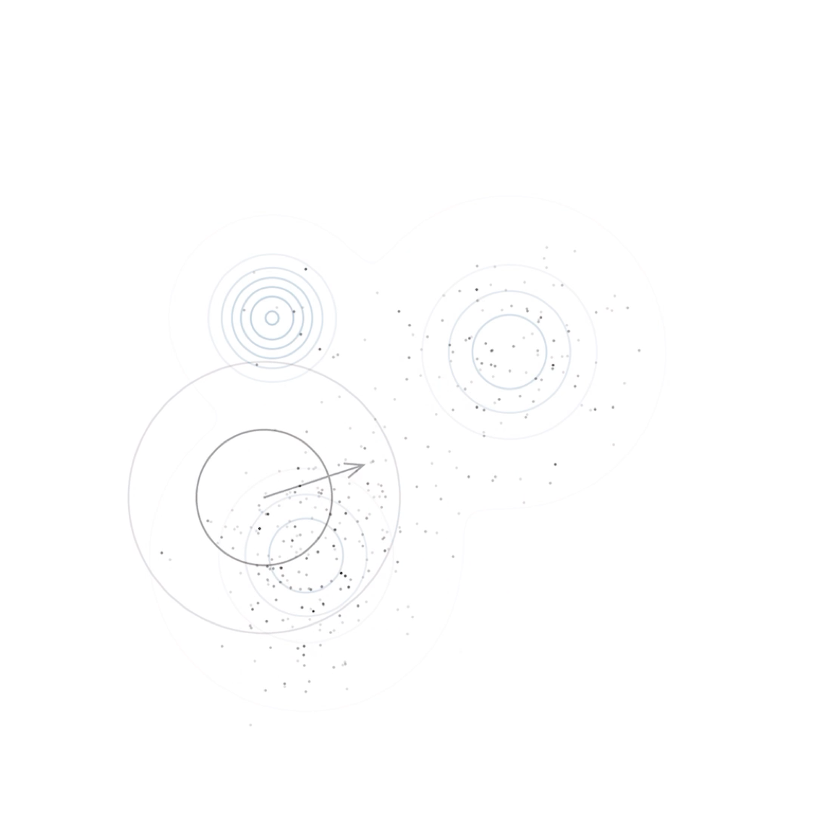
Simplest MCMC
vs.
Nested sampling
True minimum
True minimum
True minimum
Par 2
Par 2
Par 2
Local minima
Local minima
Local minima
Par 1
Par 1
Par 1
Simulations from: chi-feng/mcmc-demo
15

Slide 16
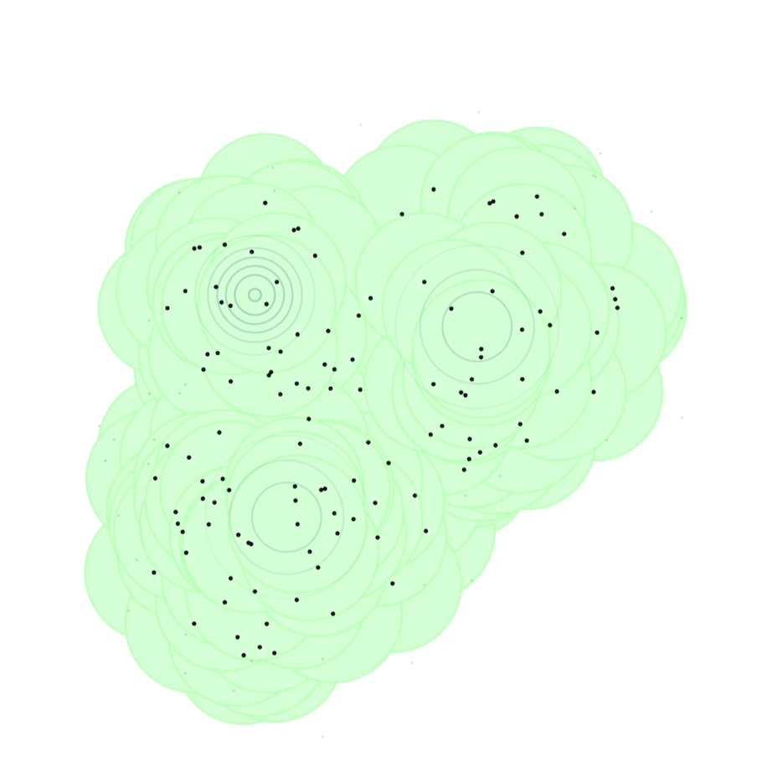
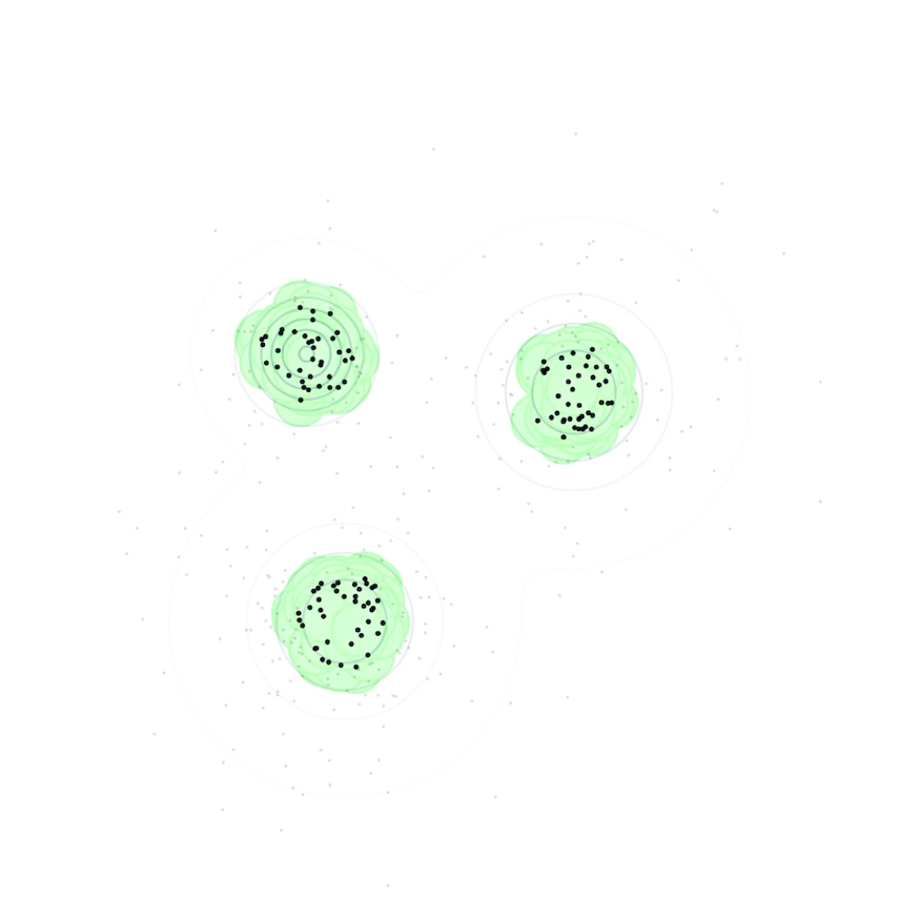
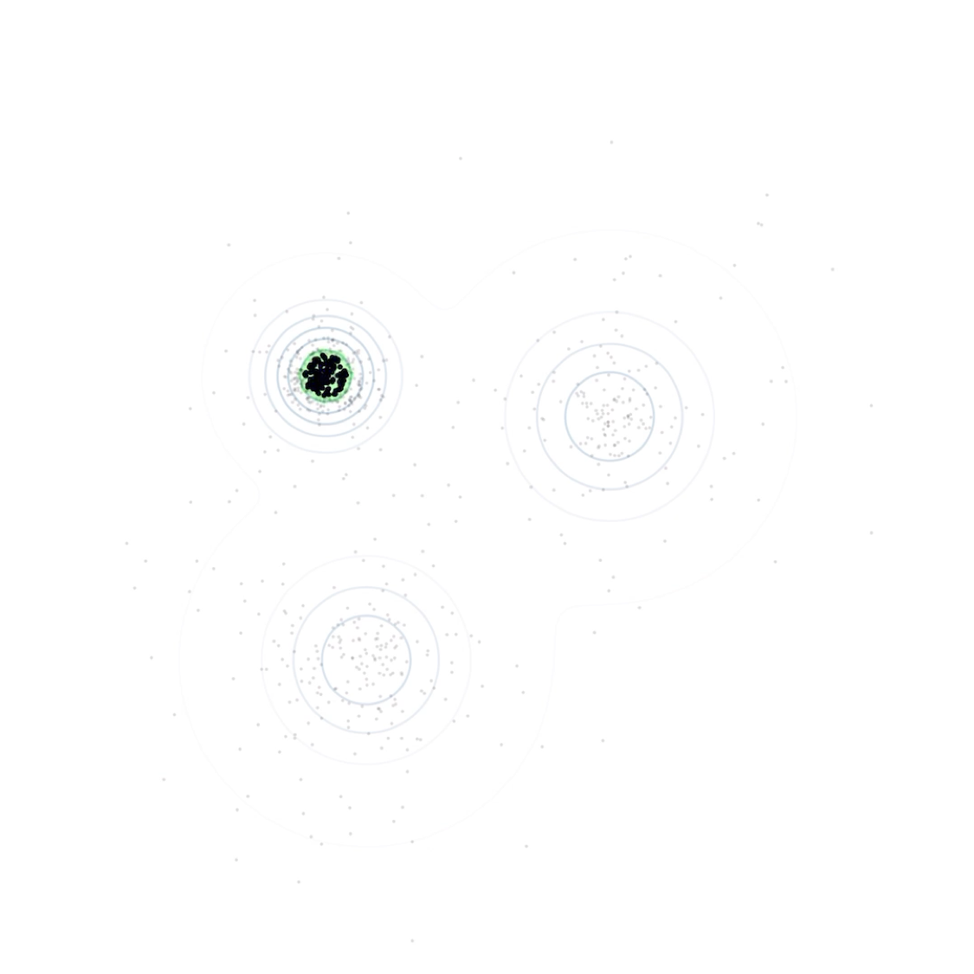
Simplest MCMC
vs.
Nested sampling
True minimum
True minimum
True minimum
Par 2
Par 2
Par 2
Local minima
Local minima
Local minima
Par 1
Par 1
Par 1
Simulations from: chi-feng/mcmc-demo
16

Slide 17
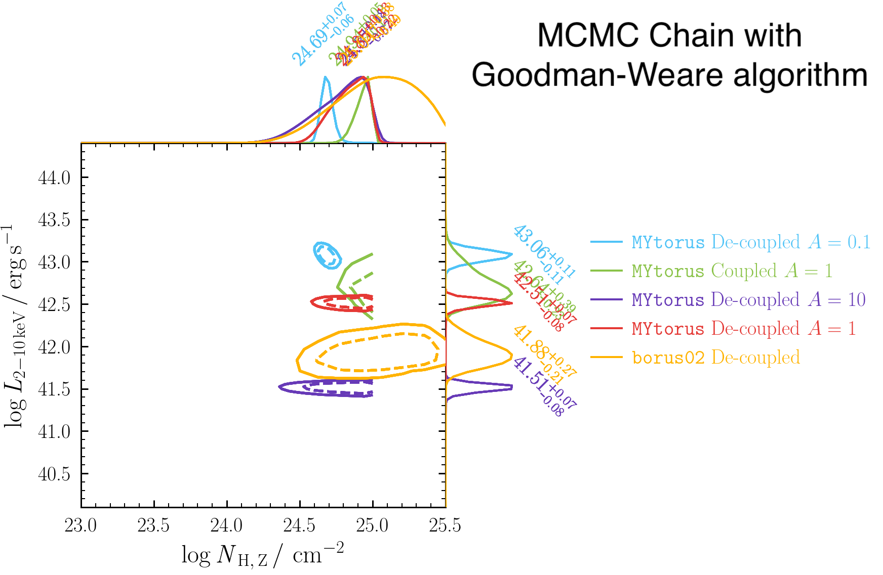
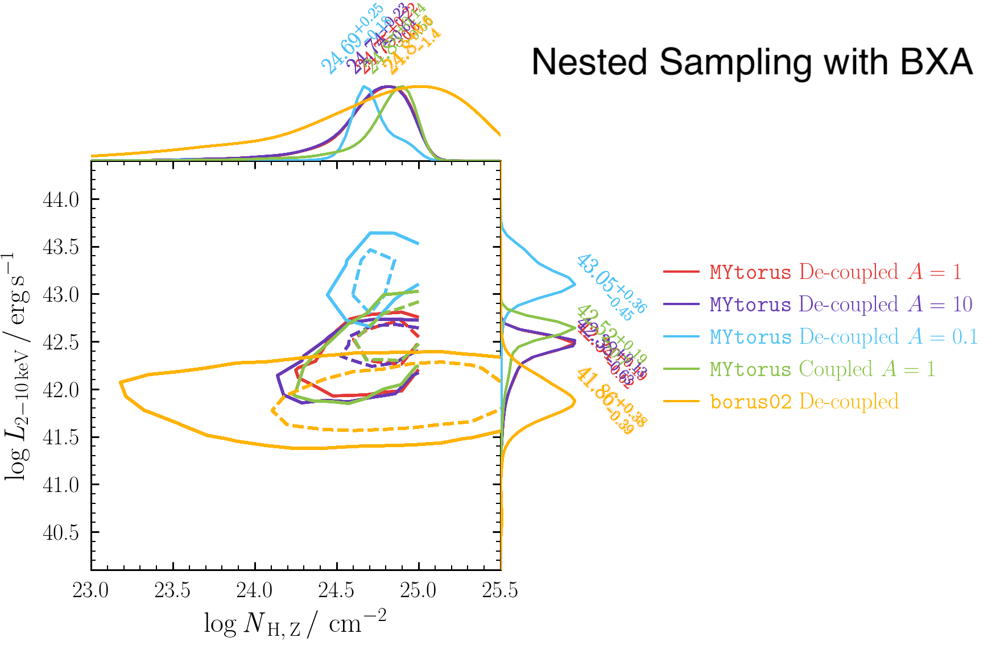
MCMC
vs.
Nested sampling
NGC 4968
14
17

Slide 18
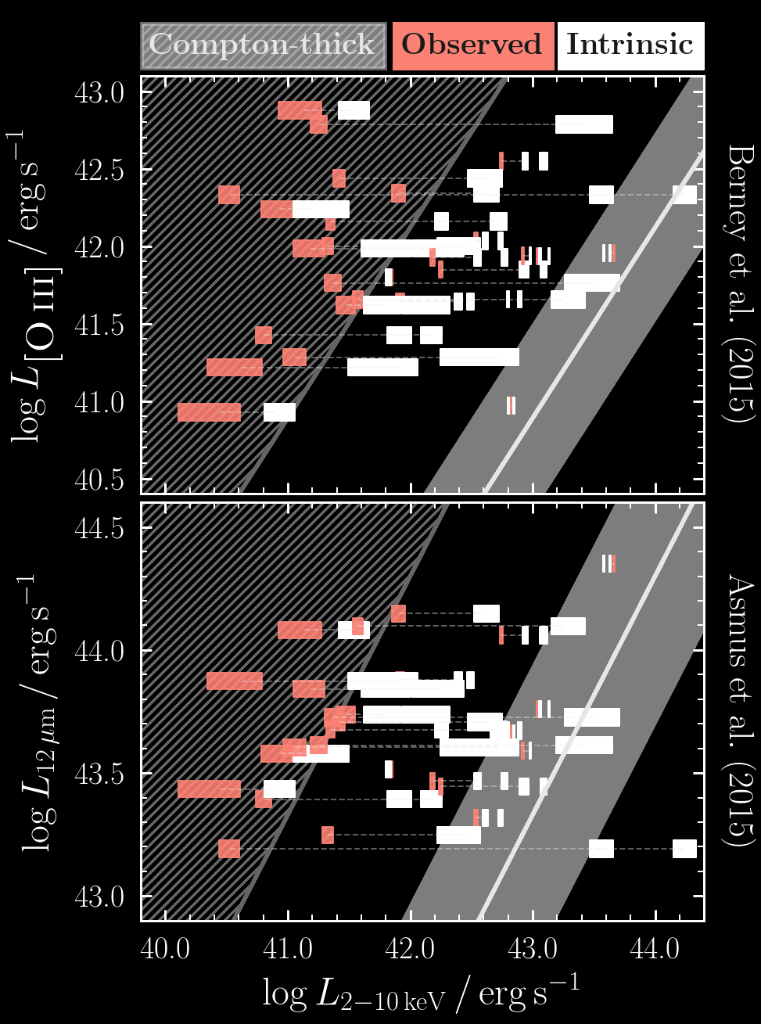
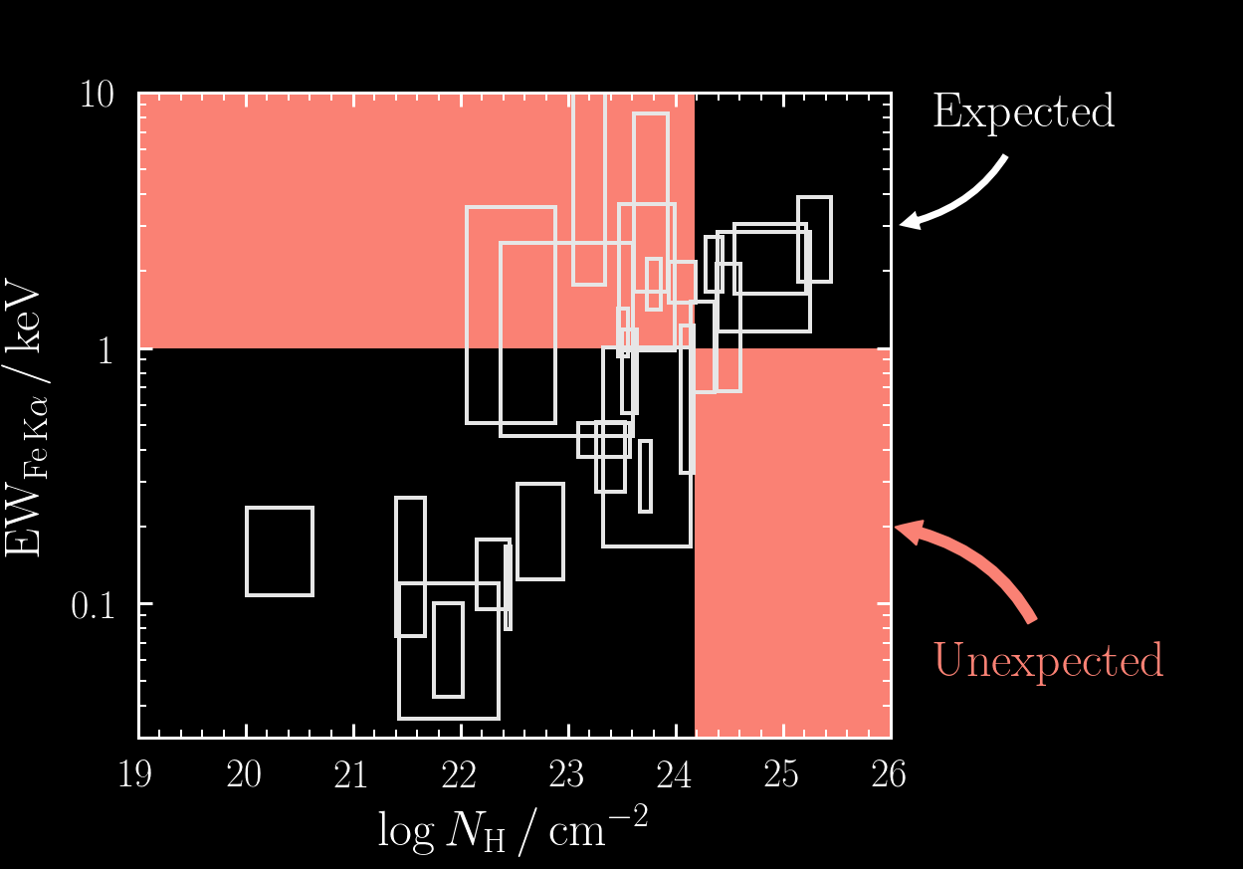
Local minima?

Slide 19
Local minima?

Slide 20
Future plan
Rectify MCMC with nested sampling
Choice of models
Circulate draft in ~ 1-2 months
20

Slide 21
Appendix

Slide 22
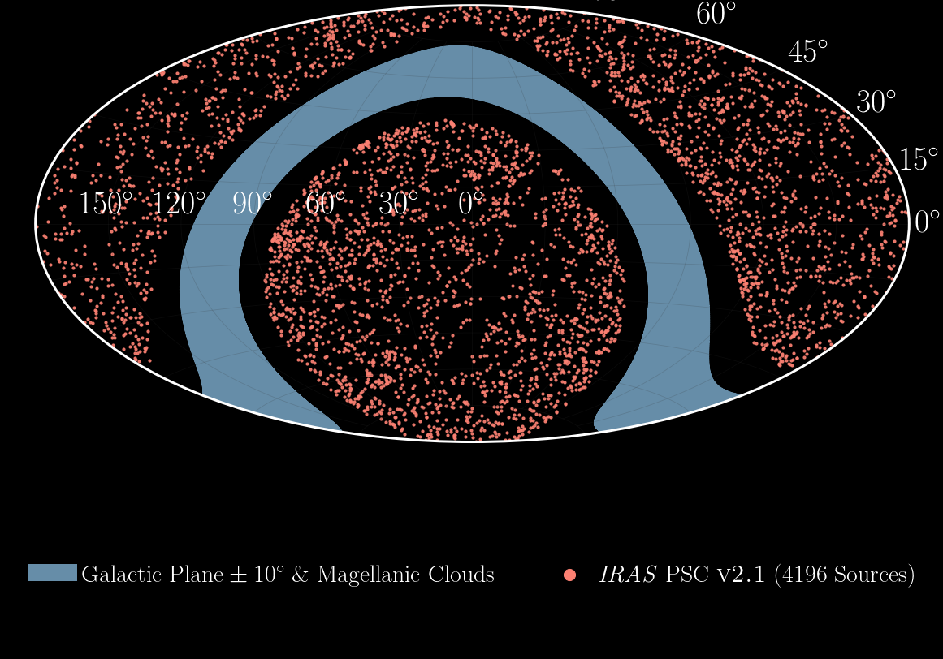
Isotropic Selection – IRAS Flux Cut
Uniform inherent prevalence of Type 1 & 2 AGN
A1

Slide 23
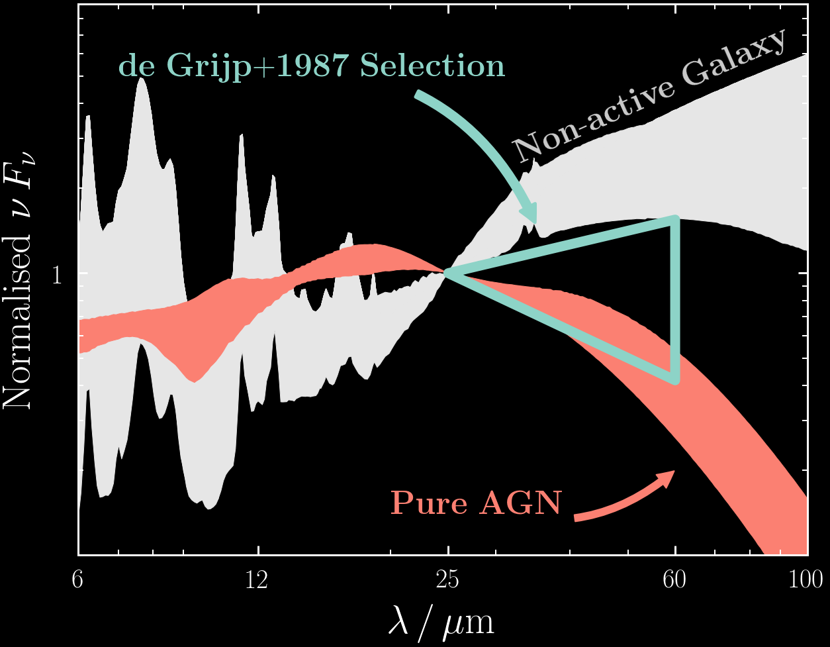
Infrared Classification - Warm Colours
3.4 μm
12 μm
4.6 μm
25 μm
12 μm
60 μm
22 μm
100 μm
A2
Mullaney+11 templates
WISE
IRAS
7

Slide 24
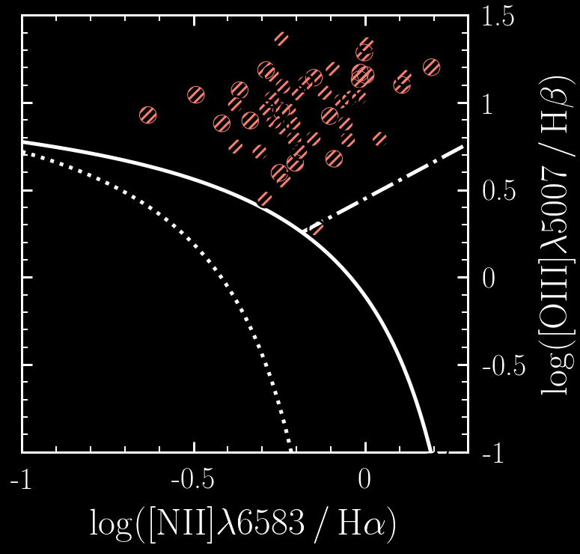
Optical Classification – Line Ratios
AGN
A3

Slide 25
Possible biases…
Infrared selection/classification:
Missing Infrared-faint AGN?
Missing Infrared-cool AGN?
Optical classification:
Missing AGN in host-dominated galaxies?
(e.g., Goulding+09, Hao+10, Buchner+17)
Optical & IR both isotropic
Boorman+,
in prep.
Type 1
Type 2
A4
Notes:
NuLANDS is not designed to be complete. Our goal is to be unbiased against X-ray flux-limited (i.e. N_{H}) selection.
In standard orientation-based AGN Unification, none of the above introduce X-ray biases.
In other schemes, any biases will preferentially miss Type 2 AGN, resulting in a robust lower limit to the Compton-thick fraction.

Slide 26
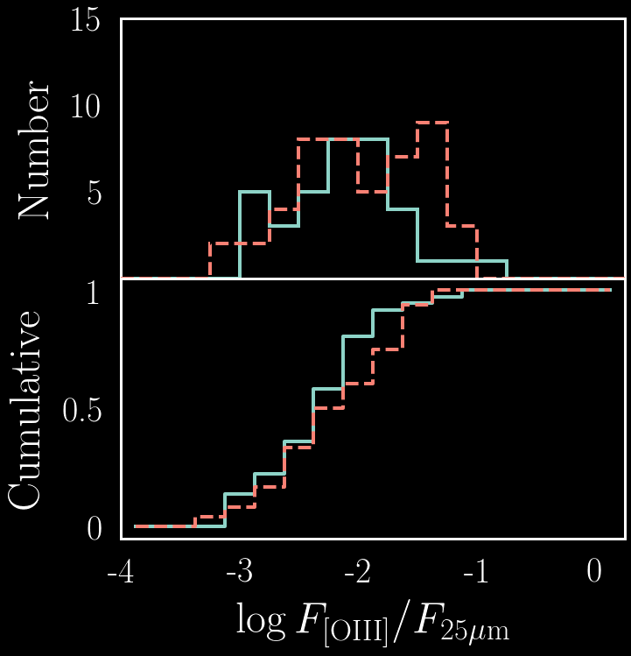
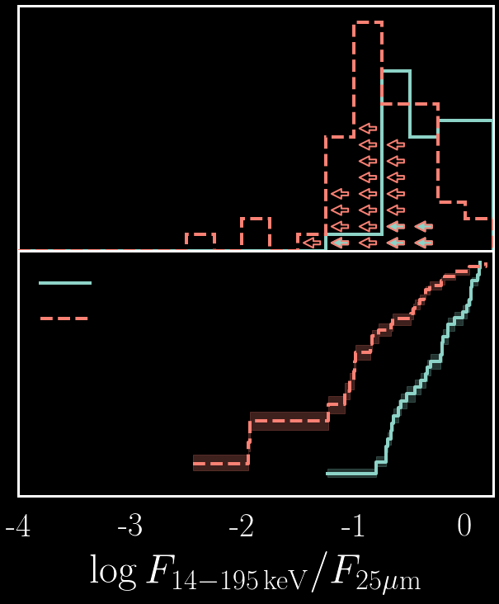
Is NuLANDS dominated by mergers?
Boorman+,in prep.
AGN-dominated 25 μm emission is consistent with 60 μm
Type 1
Type 2
A5
Notes:
All sources were found to be AGN in the optical, with infrared colours indicative of AGN.
Proven by optical tracing infrared, showing that our sampling is representative of the underlying population.

Slide 27
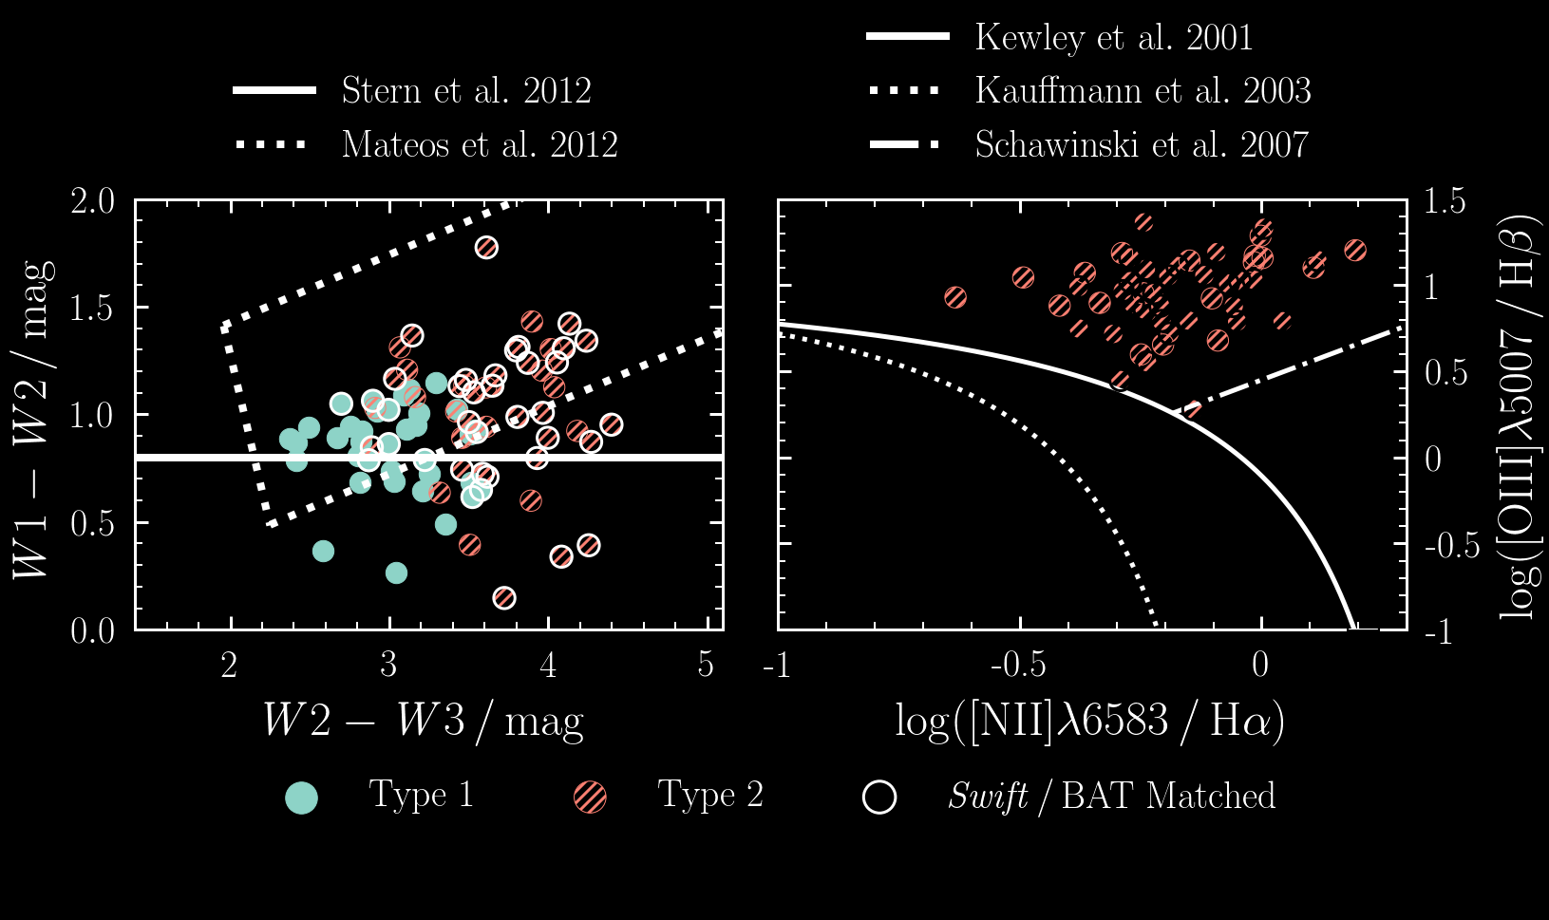
Multi-wavelength checks
A6

Slide 28
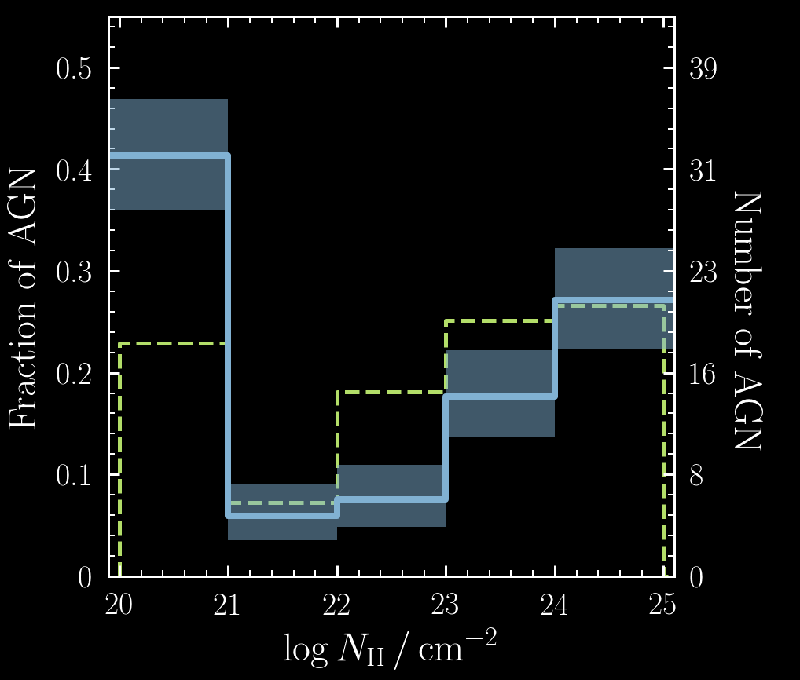
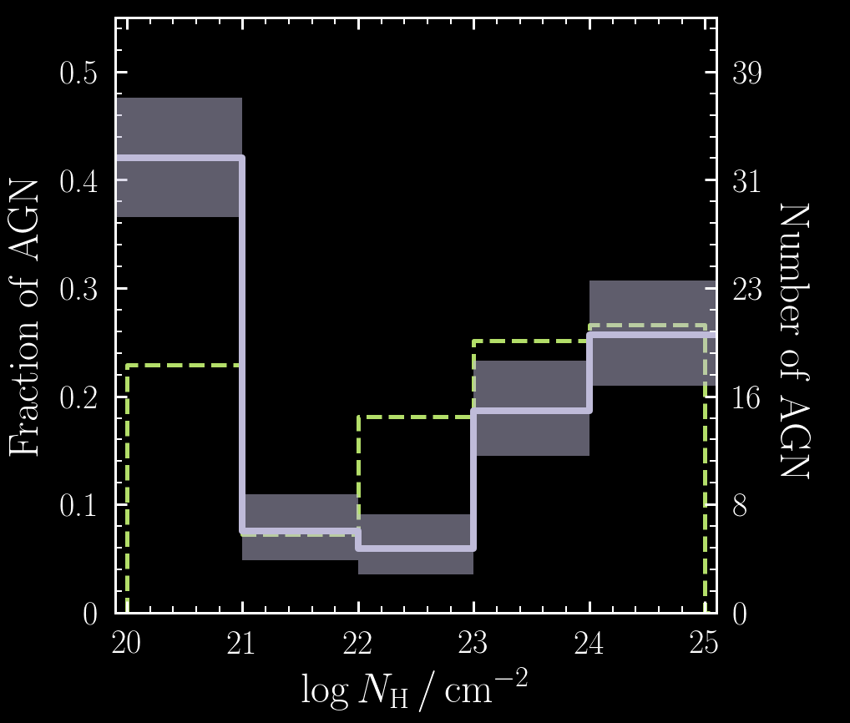
N_{H} Distribution compared to BAT (int)
NuLANDS 𝛤 free
NuLANDS 𝛤 =1.9
Swift/BAT (intrinsic)
Boorman+,in prep.
Boorman+,in prep.
A7

